Slide 1
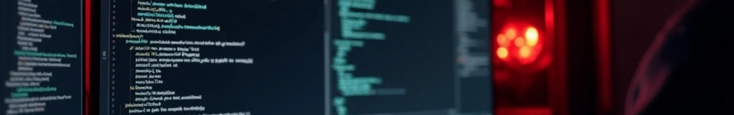

LOLBAS Lab Simulation – Bitsadmin Misuse
Prepared By: Hafsa Anwaar
NCCS INTERN

Slide 2







Objectives
Content:
1
2
3
Understand LOLBAS (Living Off the Land Binaries & Scripts).
Simulate red-team activity using bitsadmin.exe.
Analyze detection challenges and propose mitigation strategies.

Slide 3
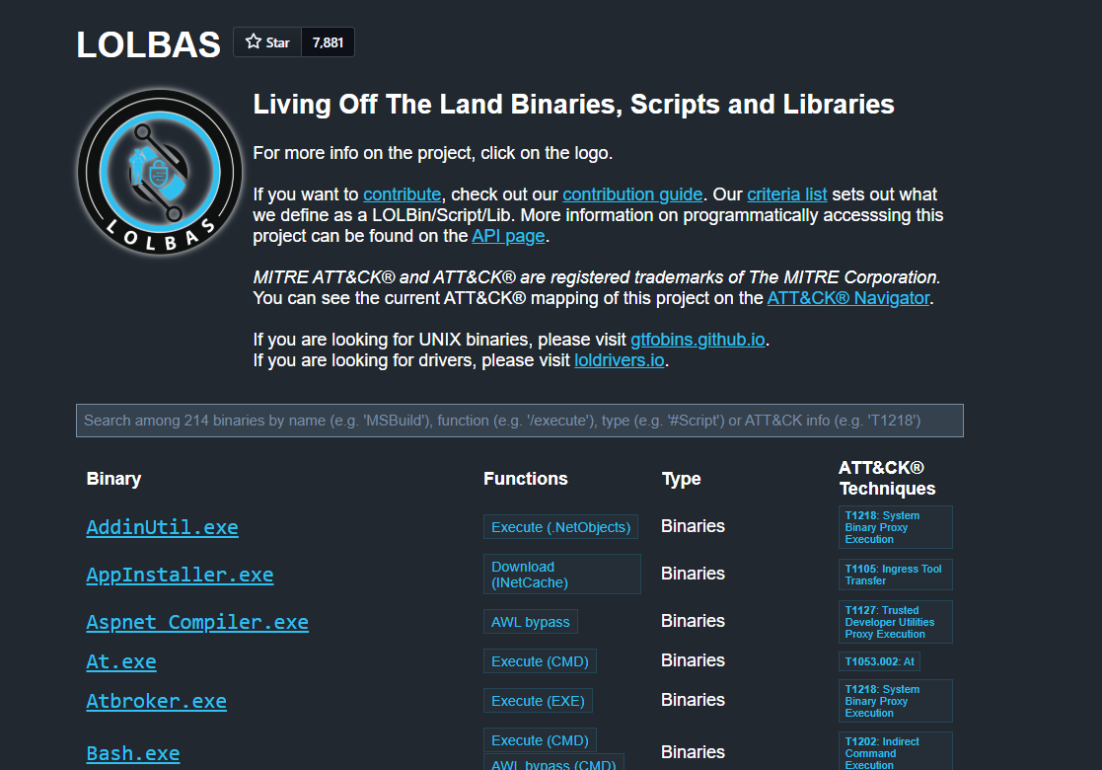
What is LOLBAS?
Legitimate binaries/scripts misused for malicious purposes.
Examples: bitsadmin.exe, mshta.exe, certutil.exe.
Risks: Evades antivirus and EDR due to trusted Windows signature.

Slide 4
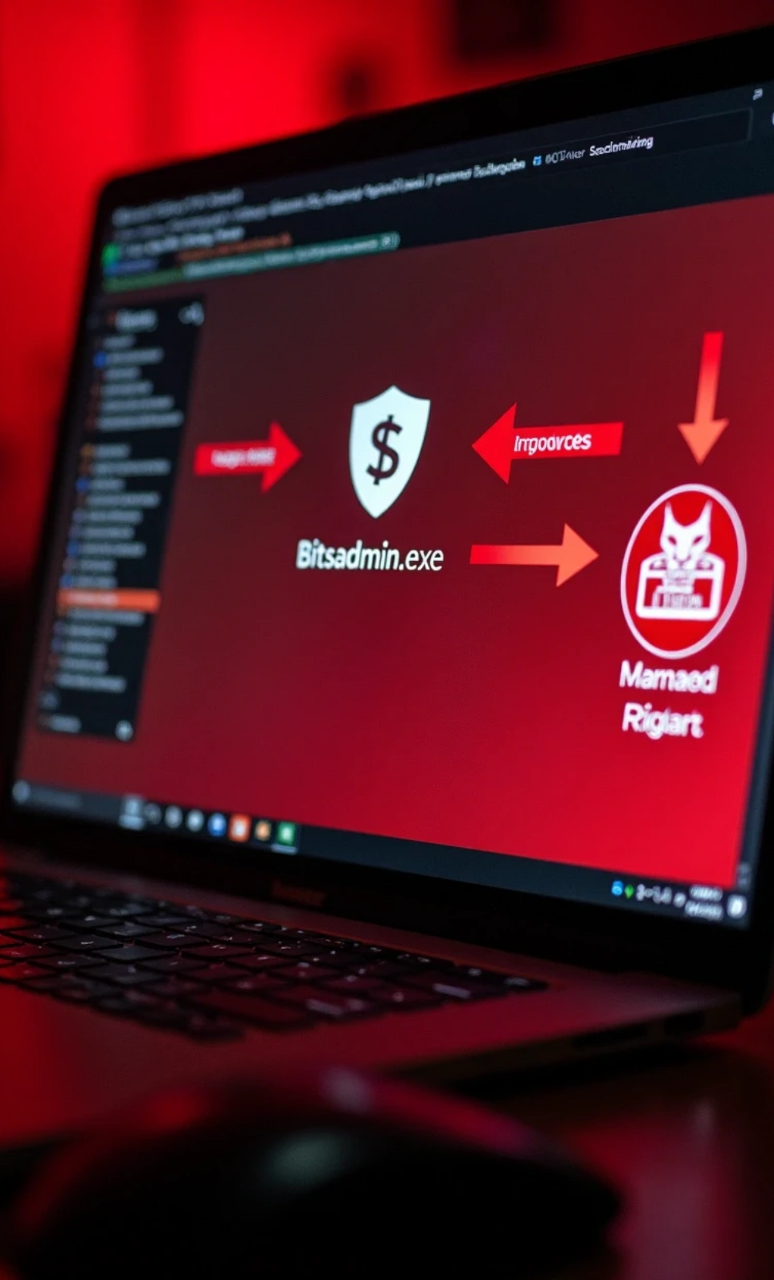







Selected Binary: Bitsadmin.exe
1
Intended Function: Manage Background Intelligent Transfer Service (BITS) jobs.
2
LOLBAS Misuse: Download remote files from attacker-controlled server.
3
MITRE ATT&CK Techniques:
• T1105: Ingress Tool Transfer
• T1218: Signed Binary Proxy Execution

Slide 5

Lab Setup
Victim
Windows 10 Pro Virtual Machine.
Attacker
Windows 10 Pro Host Machine.
Tools
bitsadmin.exe, calc.exe, hello.txt,simulate_initial_access.bat, .yml files, sigma-cli

Slide 6



Simulation Workflow
1
User executes batch file (simulate_initial_access.bat).
2
Batch runs calc.exe (benign indicator).
3
Batch runs bitsadmin.exe to download hello.txt.

Slide 7
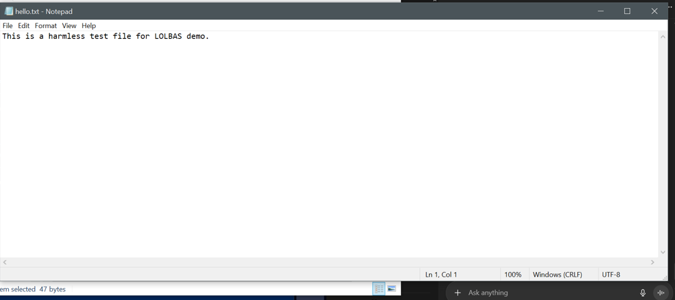
Step 1: Creating a Simple File
I first created a file named hello.txt on my Windows host machine.
This file contained a short text message which I planned to use as a payload for my simulation.

Slide 8
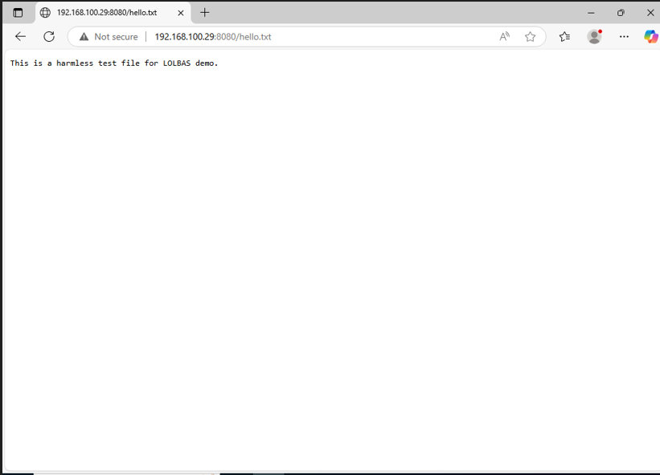
Step 2: Hosting the File on a Local Server
Next, I hosted the hello.txt file on my local server.
I verified that the file was accessible by opening my web browser and navigating to http://<server-ip>/hello.txt.
As expected, I could see the contents of the file in the browser.

Slide 9
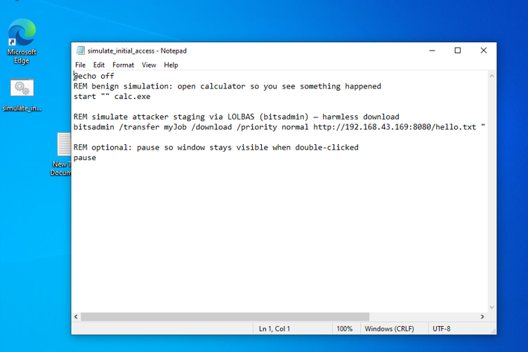
Step 3: Create a benign “initial access” payload on the VM
Next I created a small batch file that simulates a user double-clicking a malicious attachment. It will:
Launch calc.exe (harmless visible indication), and
Use bitsadmin to download hello.txt from your host — this simulates payload staging via a LOLBAS binary.
Create the batch file inside the VM (for example on the Desktop):
Open Notepad in the VM and paste:

Slide 10
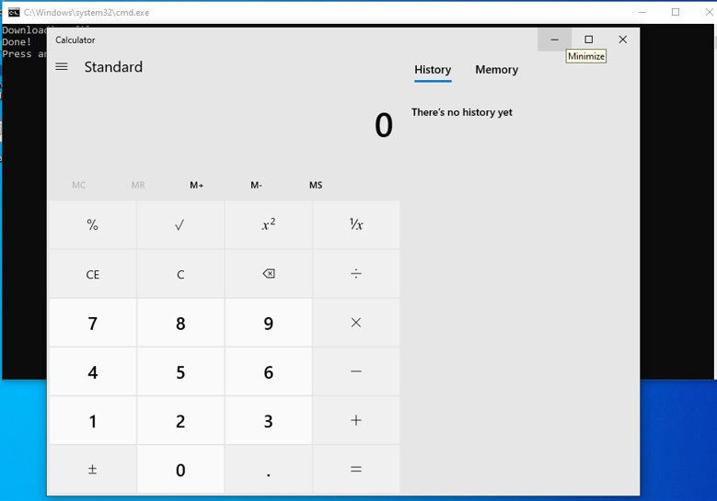
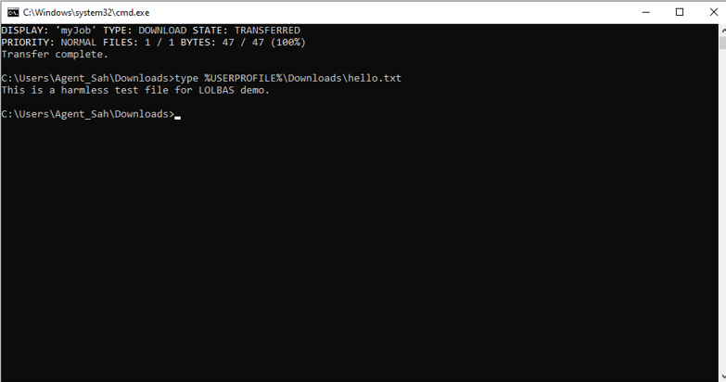
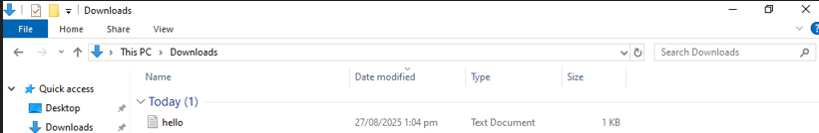
Step 4 : Execute the simulated initial access (victim action)
In the VM, double-click simulate_initial_access.bat.
Calculator should open.
The benign file should be downloaded into Downloads\hello.txt.
1. Suppose the phishing was crafted and the victim opened this .bat file thinking that it is a non-suspicious file through any email attachment
2. As a result the calculator opened
3.The file got downloaded in the backend (it can be any malicious file that the attacker wants your system to be launched with).

Slide 11



Observing the Lab
Event Logs
• 4688 → cmd.exe executed
• 4688 → bitsadmin.exe executed
Challenges
• Trusted Microsoft binaries appear normal.
• Command line shows unusual parameters.

Slide 12
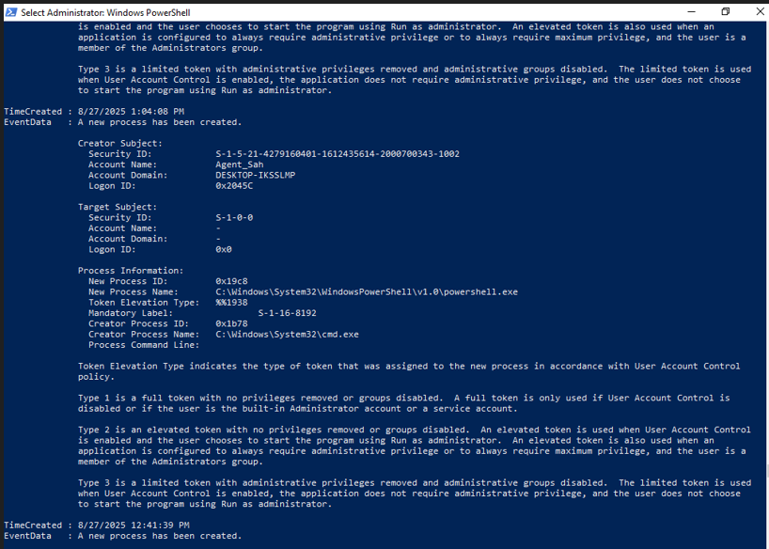
Step 5: Monitoring the logs for the process
Check that the commands were logged (Process Creation 4688):
1. This log shows the ununsual process that cmd was actually used to access powershell and it was actually done through the exeution of .bat file
2. It can be monitored here that bitsadmin worked in the background and opened calculator and then downloaded the file

Slide 13


Detection & Mitigation
Detection with Sigma Rules:
Behavioral & Contextual Detection:
• .yml files flag bitsadmin.exe executed from interactive sessions with /download.
• Monitor unusual network connections initiated by trusted Windows binaries.
• Parent-child process correlation: cmd.exe → bitsadmin.exe.
• Track downloads to unexpected file paths or locations.
Preventive Controls:
Implementation Note:
• AppLocker / WDAC: restrict execution of certain binaries from untrusted locations.
• Sigma rules ready for SIEM deployment (Azure Sentinel, Splunk, Elastic).
• Lab demonstrates conceptual detection logic without live deployment.
• User education: awareness of suspicious files and attachments.
Sigma rules are platform-agnostic and show readiness for real deployment.

Slide 14
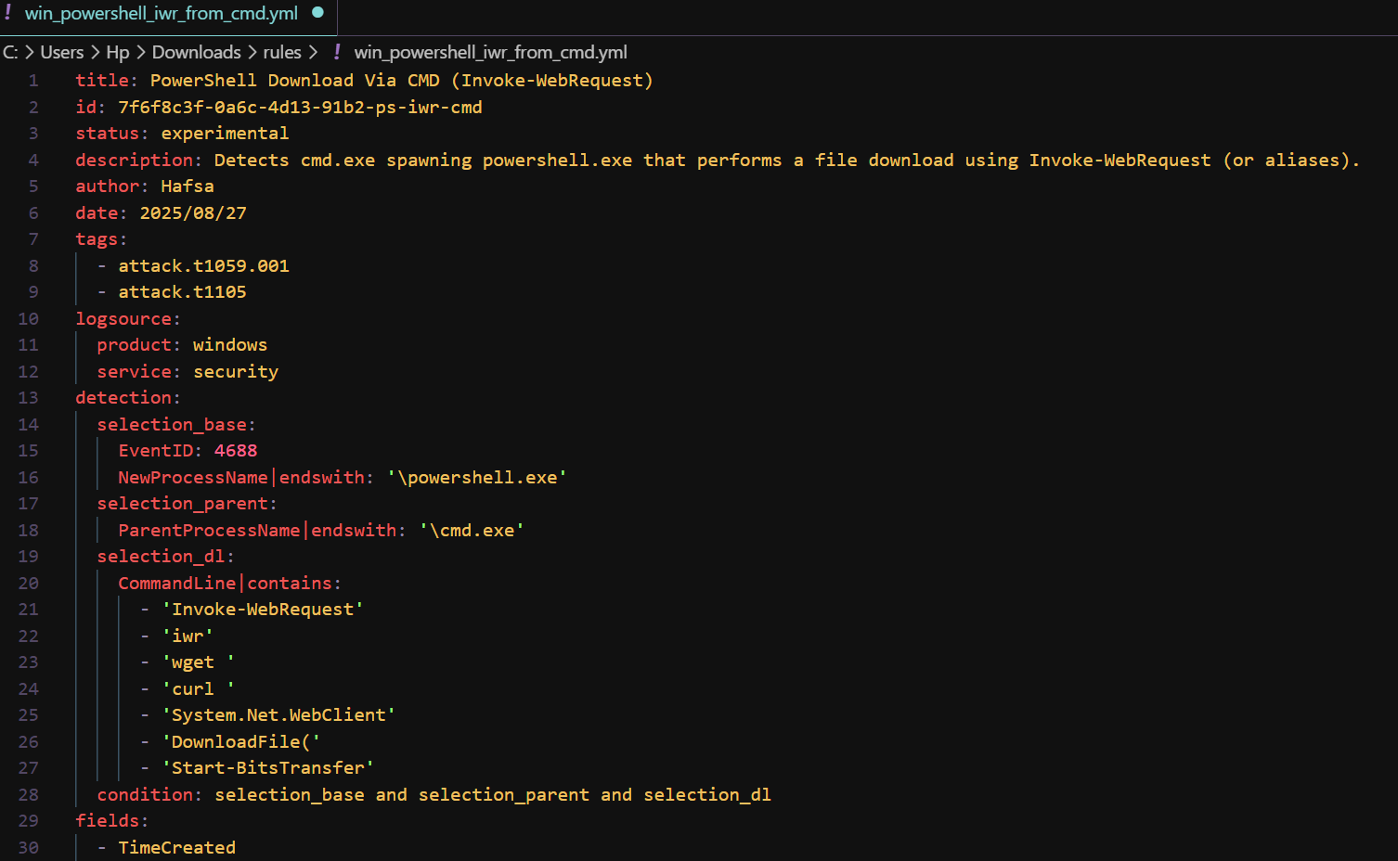
1.0 Detecting PowerShell Download via CMD
PowerShell File Download via CMD (Invoke-WebRequest)
What It Detects:
cmd.exe spawning powershell.exe to download files using Invoke-WebRequest (or aliases like iwr, wget, curl).
Also detects downloads via System.Net.WebClient, DownloadFile(), or Start-BitsTransfer.
Why It Matters:
Attackers can use PowerShell to download payloads stealthily.
The parent-child correlation (cmd.exe → powershell.exe) helps distinguish malicious activity from normal PowerShell use.
Detection Logic (Sigma YAML):
EventID: 4688 (process creation)
NewProcessName: powershell.exe
ParentProcessName: cmd.exe
CommandLine contains download commands
Risk Level: High

Slide 15
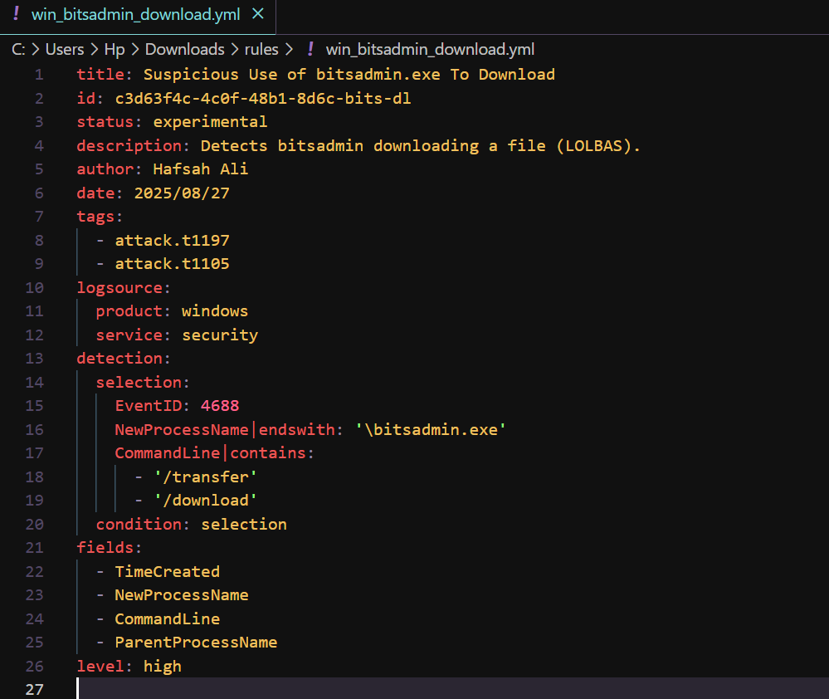
1.1 Bitsadmin File Download
Bitsadmin File Download via CMD
What It Detects:
cmd.exe launching bitsadmin.exe to download files from external sources.
Typical LOLBAS misuse for stealthy staging or payload downloads.
Why It Matters:
bitsadmin.exe is a legitimate Microsoft binary; attackers exploit it to bypass traditional defenses.
Detecting parent-child process chain helps distinguish malicious vs normal use.
Detection Logic (Sigma YAML):
EventID: 4688 (process creation)
NewProcessName: bitsadmin.exe
ParentProcessName: cmd.exe
CommandLine contains /transfer or /download
Risk Level: High

Slide 16
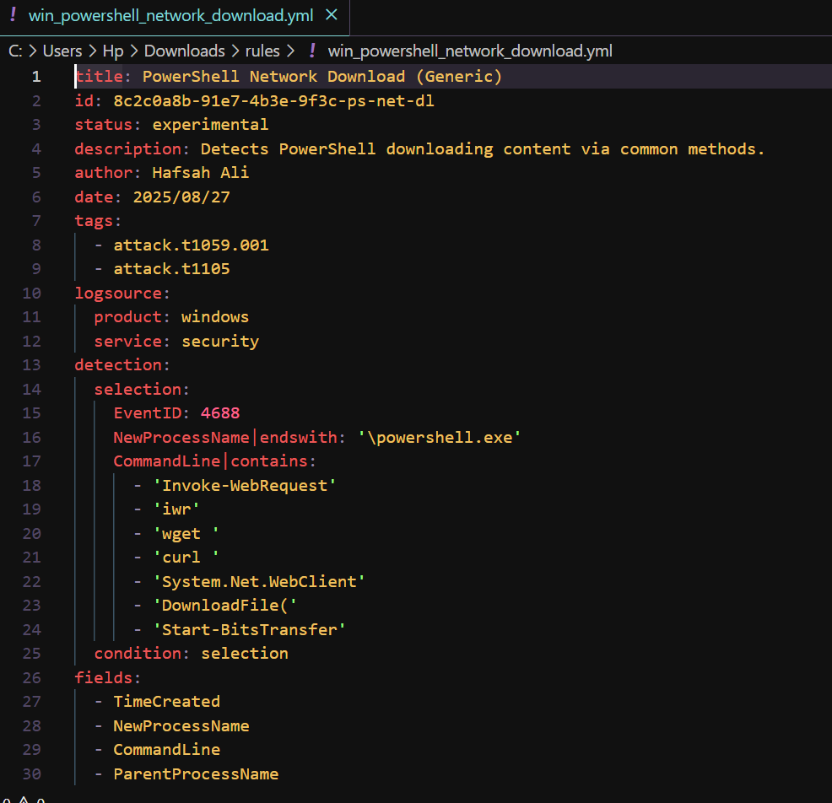
1.2 PowerShell Network Download
PowerShell Network Download via Network Commands
What It Detects:
PowerShell downloading files via network commands:
Invoke-WebRequest, iwr, wget, curl, System.Net.WebClient, DownloadFile(), Start-BitsTransfer
Parent process could be cmd.exe or other scripts.
Why It Matters:
PowerShell is often used in red-team operations to download payloads without touching disk.
Detecting this activity early helps prevent malware execution and lateral movement.
Detection Logic (Sigma YAML):
EventID: 4688
NewProcessName: powershell.exe
CommandLine contains network download functions
Optional parent correlation: cmd.exe
Risk Level: High

Slide 17
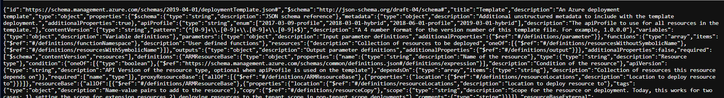
2. Converting these sigma rules to json for counter measure in real world
Purpose of Conversion:
Sigma rules are platform-independent templates.
Converting to JSON makes them ready to import into Azure Sentinel as custom detection rules.
Enables real-world SIEM monitoring for malicious activity, even if the lab is local.
We converted three Sigma rules into JSON:
win_bitsadmin_download.json
win_powershell_iwr_from_cmd.json
win_powershell_network_download.json

Slide 18
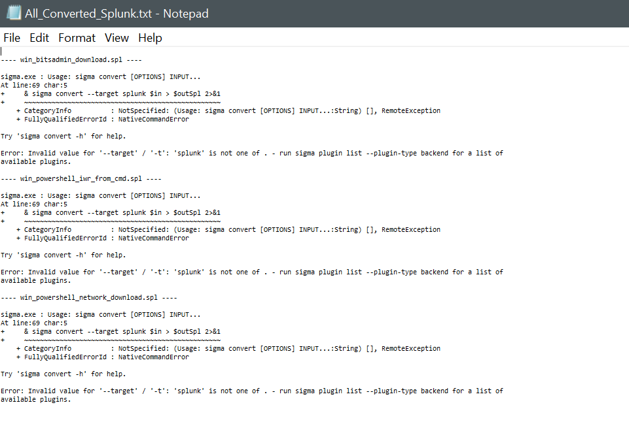
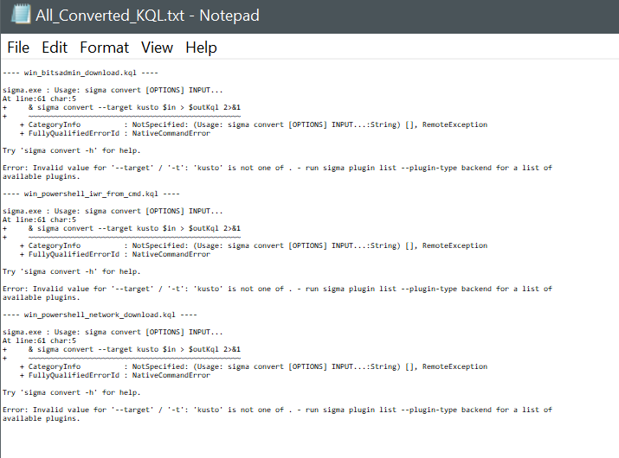
3. Converted KQL & SPL Queries
Sigma → KQL / SPL Conversion
Purpose of Conversion:
KQL (Kusto Query Language) is used in Azure Sentinel / Log Analytics.
SPL (Search Processing Language) is used in Splunk.
Converting Sigma rules into these formats allows the same detection logic to be applied across multiple SIEM platforms.
How This Helps in Countermeasures:
Supports real-time monitoring and alerting for suspicious LOLBAS activity.
Detects parent-child process chains and abnormal command-line behavior.
Enables security teams to respond faster to attacks in production environments

Slide 19







Conclusion
1
2
LOLBAS abuse enables stealthy attacker activity.
Safe lab demonstrates bitsadmin.exe misuse.
3
4
Detection requires behavioral & contextual monitoring.
Mitigation: conceptual Sigma rules, AppLocker/WDAC, network monitoring, and user awareness.

Slide 20

Thank You

